Slide 1
SUMMER TRAINING PROJECT REPORT
1
FTK-Centre for Information Technology
JAMIA MILLIA ISLAMIA
PROJECT NAME: Architecture of network in JMI
Submitted by:
Md. Atif Hussain
Md. Asif Hussain
Aquib Raushan
Ibrahim Tamimi
Zubair Alam
Ali Abu Bakr
Aayan Khan
Submitted to:
Mr. Sunil
Assistant professor
Training & placement coordinator

Slide 2
Computer Networks
2
Learning outcomes:
Define computer networks.
Define communications.
Types of computer networks.
Importance of communication and networks.

Slide 3
3
“ establishing a network isn’t like following a recipe for brownies. A lot of people think you can buy two devices, connect them with a wire and be done with it,…have the person who knows the most [about computers], read the manual and do the job. ”
~anonymous

Slide 4
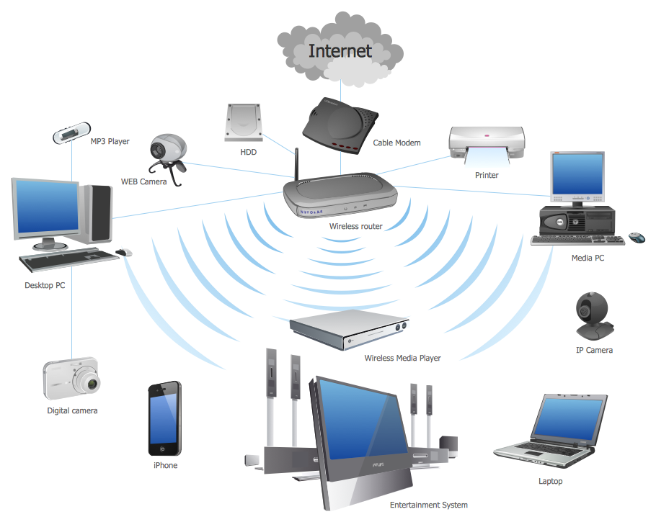
Computer Network
4
A computer network is a group of computer systems and other computing hardware devices that are linked together through communication channels to facilitate communication and resource-sharing among a wide range of users.

Slide 5
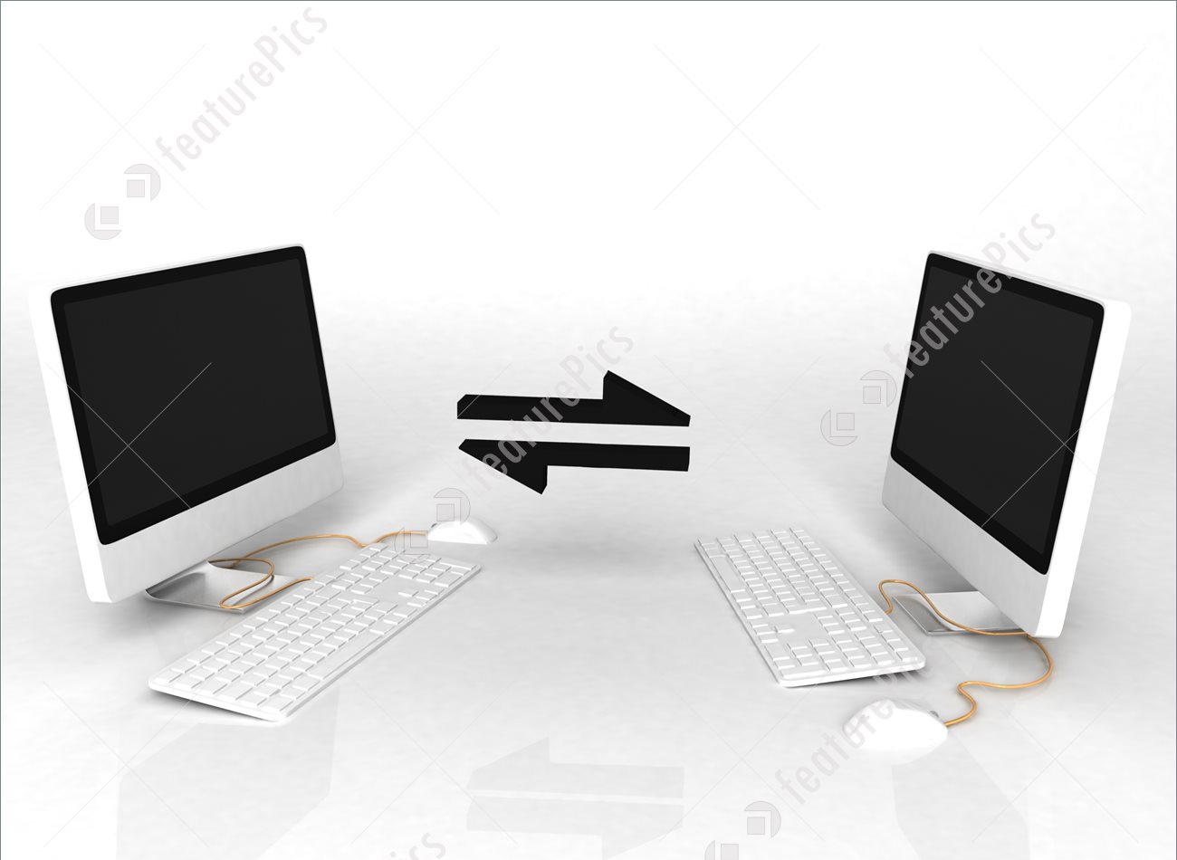
Communication
5
The transmission of data from one computer to another, or from one device to another. A communications device, therefore, is any machine that assists data transmission. For example, modems, cables, and ports are all communications devices. Communication/data transmission is done by transfer of energy called signals through transmission media.

Slide 6
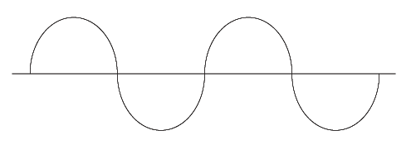
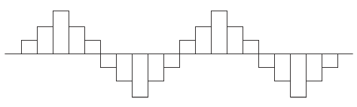
signals
6
Analog signal
Digital signal
An analog signal is a continuous wave denoted by a sine wave (pictured below) and may vary in signal strength (amplitude) or frequency (waves per unit time). The sine wave's amplitude value can be seen as the higher and lower points of the wave, while the frequency value is measured in the sine wave's physical length from left to right.
A digital signal refers to an electrical signal that is converted into a pattern of bits. Unlike an analog signal, which is a continuous signal that contains time-varying quantities, a digital signal has a discrete value at each sampling point. The precision of the signal is determined by how many samples are recorded per unit of time.

Slide 7
OSI(Open System Interconnection) Model
7
The Open Systems Interconnection model (OSI model) is a conceptual model that characterizes and standardizes the communication functions of a telecommunication or computing system without regard to its underlying internal structure and technology. Its goal is the interoperability of diverse communication systems with standard communication protocols. The model partitions a communication system into abstraction layer. The original version of the model had seven layers.
A layer serves the layer above it and is served by the layer below it. For example, a layer that provides error-free communications across a network provides the path needed by applications above it, while it calls the next lower layer to send and receive packets that constitute the contents of that path. Two instances at the same layer are visualized as connected by a horizontal connection in that layer.

Slide 8
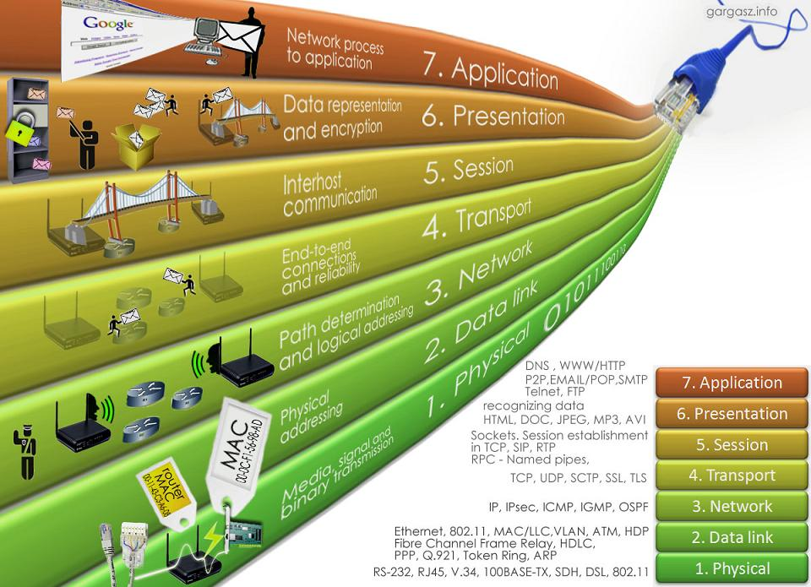
Layers of OSI model
8

Slide 9
Networking devices
9
Repeater
Bridge
Hub
Active hub
Passive hub
Switch
Gateway

Slide 10
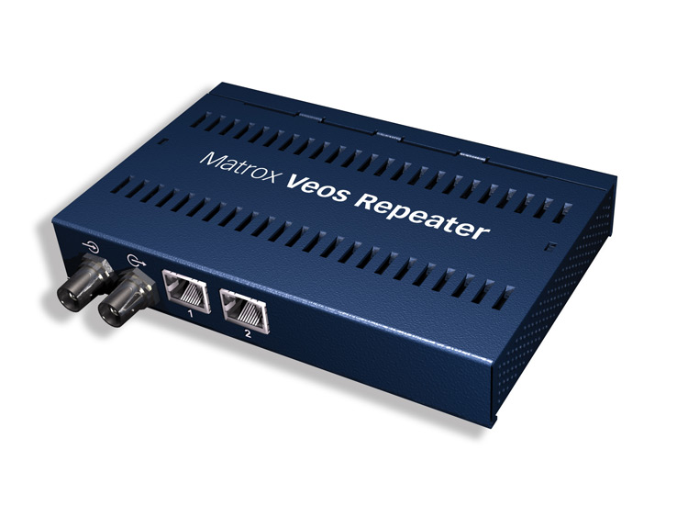
repeater
10
A repeater operates at the physical layer. Its job is to regenerate the signal over the same network before the signal becomes too weak or corrupted so as to extend the length which can be transmitted over the same network. An important point to be noted about repeaters is that they do not amplify the signal. When the signal becomes weak, they copy the signal bit y bit and regenerate it at its original strength. It is a 2-port device.

Slide 11
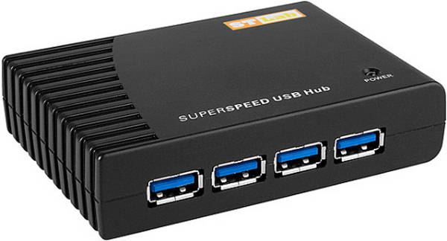
Hub
11
When referring to a network, a hub is the most basic networking device that connects multiple computers or other network devices together.
A Hub is a connection point in a network where data from many directions converge and are sent out in many directions to respective devices.

Slide 12
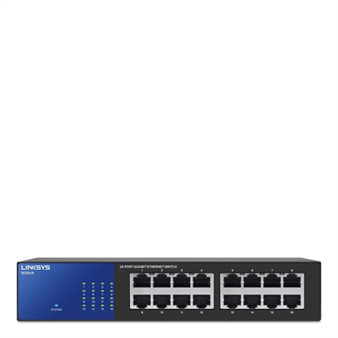
Switch
12
A switch is a multi-port bridge with a buffer and d design that can boost its efficiency and performance. It performs error check before forwarding data, that makes it very efficient as it does not forward packets that have errors and forward good packets selectively to correct port only. In other words, switch divides collision domain of hosts, but broadcast domain remains same.

Slide 13
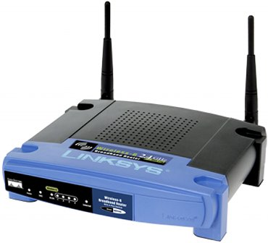
Router
13
A router is a device like a switch that routes data packets based on their IP addresses. Router is mainly a network layer device. Routers normally connect LANs and WANs together and have a dynamically updating routing table based on which they make decisions on routing the data packets. Router divide broadcast domains of hosts connected through it.

Slide 14
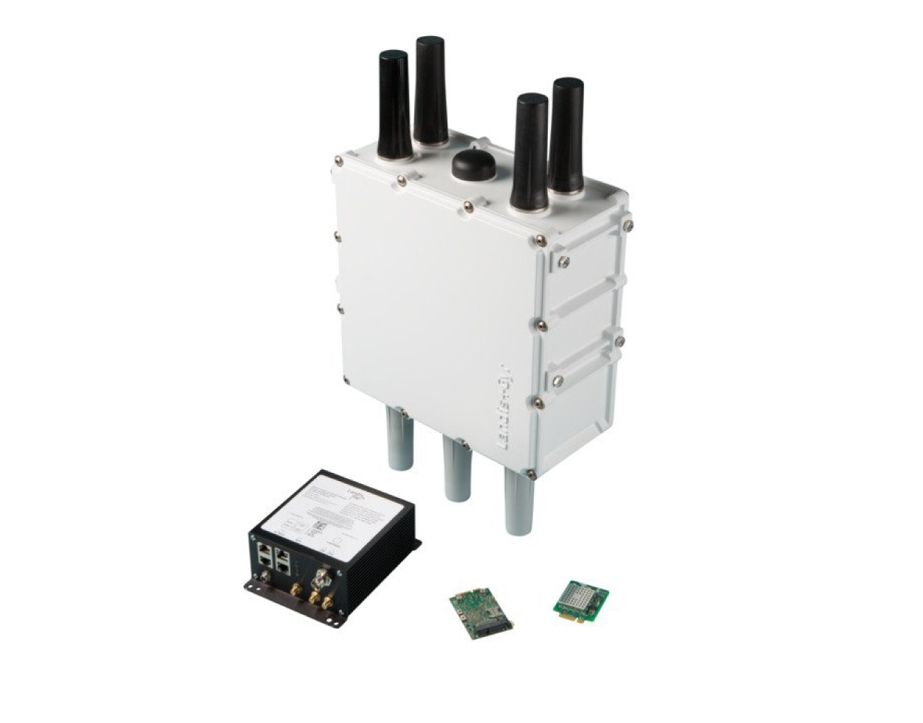
gateway
14
A gateway, as the name suggests, is a passage to connect two networks together that may work upon different networking models. They basically works as the messenger agents that take data from one system to another system. Gateways are also called protocol converters and can operate at any network layer. Gateways are generally more complex than the network switches or routers.

Slide 15
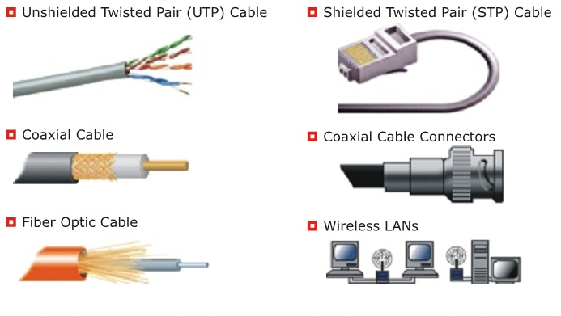
Networking cables
15
Networking cables are networking hardware used to connect one network device to other network devices or to connect two or more computers to share printers, scanners etc. Different types of network cables, such as coaxial cable, optical fiber cable, and twisted pair cables, are used depending on the network's physical layer, topology, and size.

Slide 16
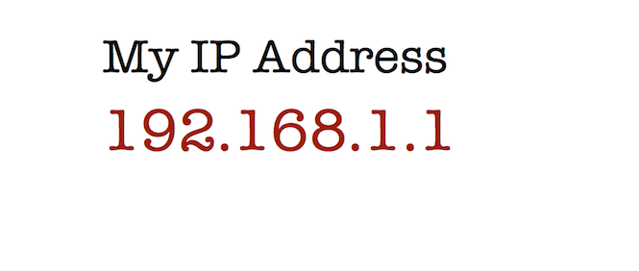
IP address
16
An Internet Protocol address (IP address) is a logical numeric address that is assigned to every single computer, printer, switch, router or any other device that is part of a network.
The IP address is a numeric address assigned to every unique instance that is connected to any computer communication network

Slide 17
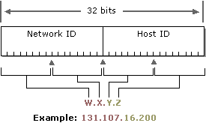
Components of an IP address
17

Slide 18
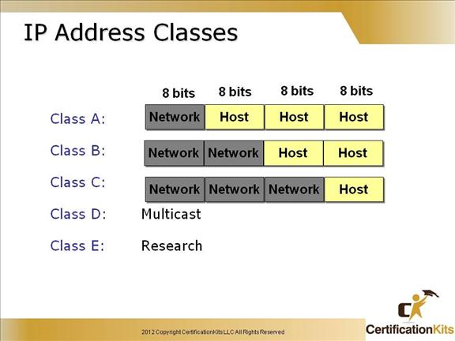
18

Slide 19
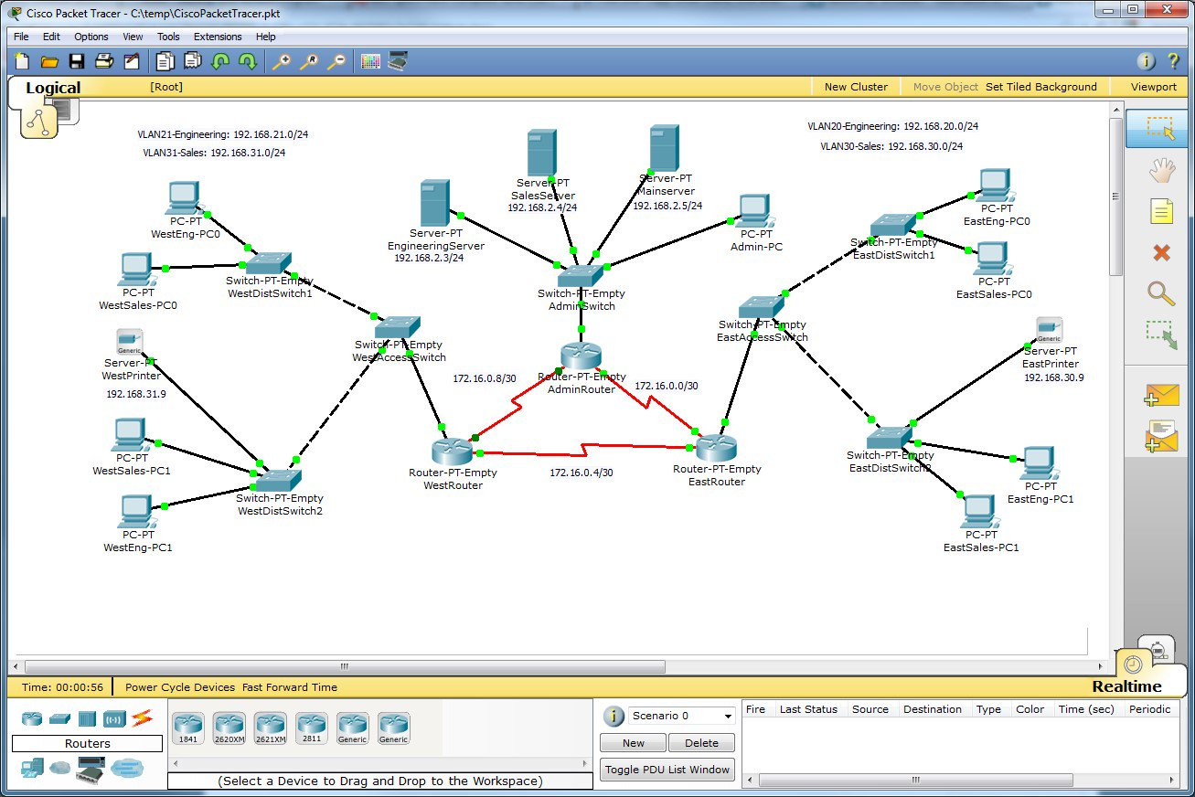
Cisco packet tracer
19
Packet Tracer is a cross-platform visual simulation tool designed by Cisco Systems that allows users to create network topologies and imitate modern computer networks. The software allows users to simulate the configuration of Cisco routers and switches using a simulated command line interface. Packet Tracer makes use of a drag and drop user interface, allowing users to add and remove simulated network devices as they see fit.

Slide 20
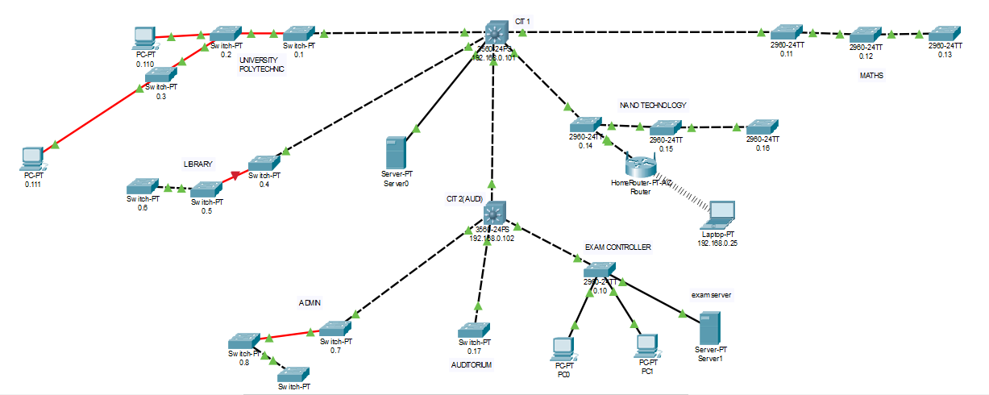
JMI network simulation
20

Slide 21
overview
21
The image in the previous slide is an overview of the network in our university, Jamia Millia Islamia. Cisco packet tracer enabled us to create a simulation of the network being used in Jamia without the need for using the real hardware and worrying about conditions. Some of the key features used in the simulation:
DHCP(Dynamic Host Configuration Protocol) server
PING(Packet InterNet Groper)
CLI(Command Line Interface) in switches.

Slide 22
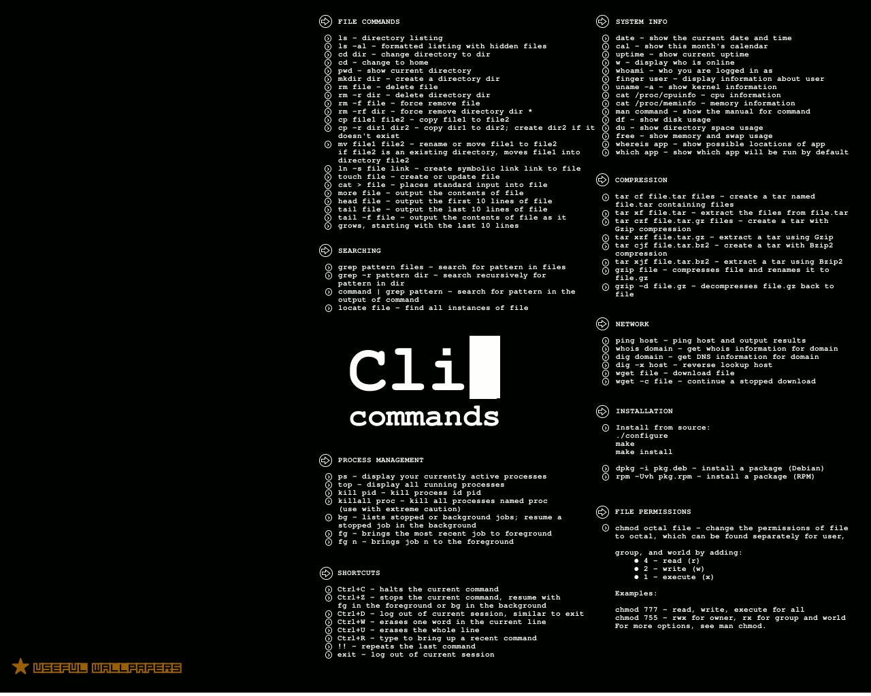
CLI
22
A command line interface (CLI) is a means of interacting with a computer program where the user (or client) issues commands to the program in the form of successive lines of text (command lines), the program which handles the interface is called a command line interpreter or command line processor.

Slide 23
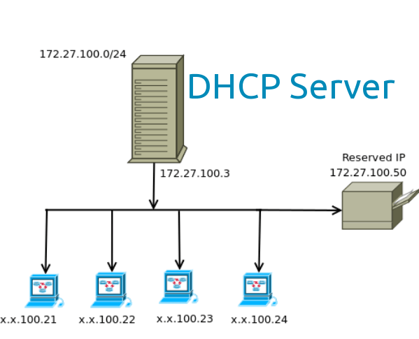
DHCP server
23
A DHCP server is a network server that automatically provides and assigns IP addresses, default gateways and other network parameters to client devices. It relies on the standard protocol known as the Dynamic Host Configuration Protocol to respond to the broadcast queries by clients.

Slide 24
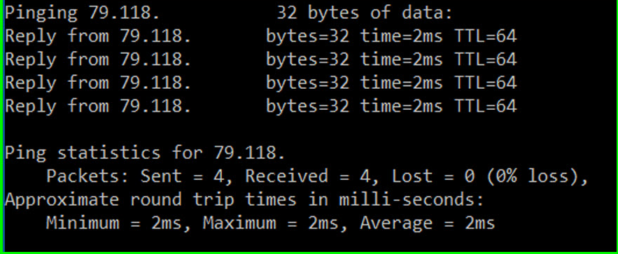
PING
24
PING is a basic internet program that allows a user to verify that a particular IP address exists and can accept requests.
Ping is used diagnostically to ensure that the user is trying to reach is actually operating. Ping works by sending an Internet Control Message Protocol(ICMP) echo request to a specified interface on the network and waiting for a reply.

Slide 25
We have uploaded a webpage on the Jamia’s network too, You can access it on:
25
10.2.0.35/project/

Slide 26
Acknowledgement
26
First of all, I would like to express my gratitude to Almighty Allah to enabling me to complete this project report on “Architecture of Network of JMI ”. with this, some of the people to which I am indebted are:
Dr. S. M. K. Quadri (Honorary Director-CIT, JMI)
Mr. Syed Khalid Ali (Network Engineer-CIT, JMI)
Mr. Abuzar (Trainer)
and my group members, who provided their valuable suggestions and precious time in accomplishing my project report.

